Slide 1


Shoulder Anatomy
Mia Preece
m.preece1@londonmet.ac.uk

Slide 2
Overview
Bones and bony landmarks
Joints and their movements
Ligaments
Muscles

Slide 3
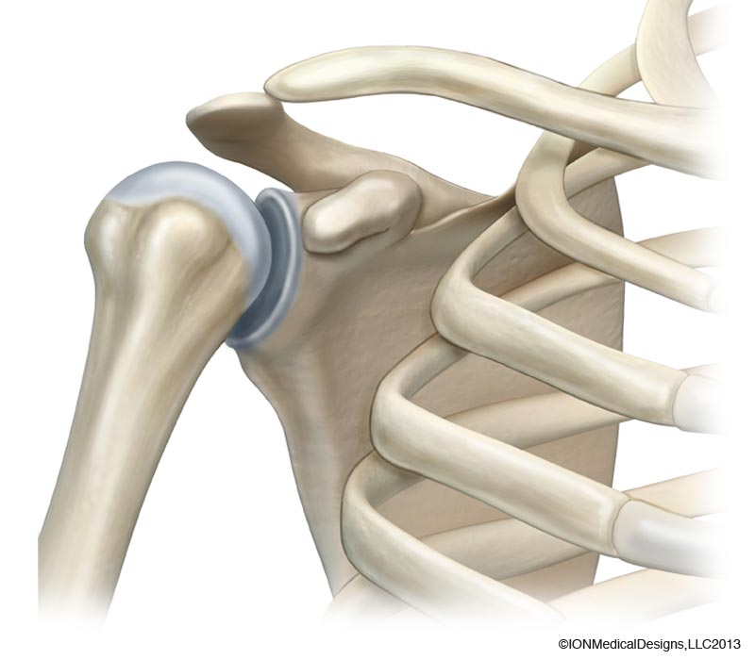
Clavicle
The Shoulder Complex
Comprises of three bones:
Humerus (upper arm)
Scapula (shoulder blade)
Clavicle (collarbone)
Humerus
MORE THAN ONE JOINT!
Scapula

Slide 4
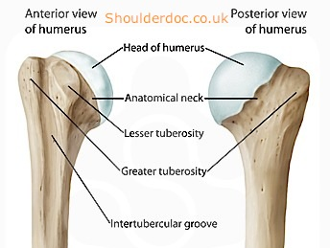
Key bony landmarks
Humerus:
Greater tubercle
Lesser tubercle
Intertubercular groove
(bicipital groove)

Slide 5
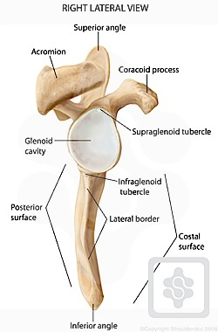
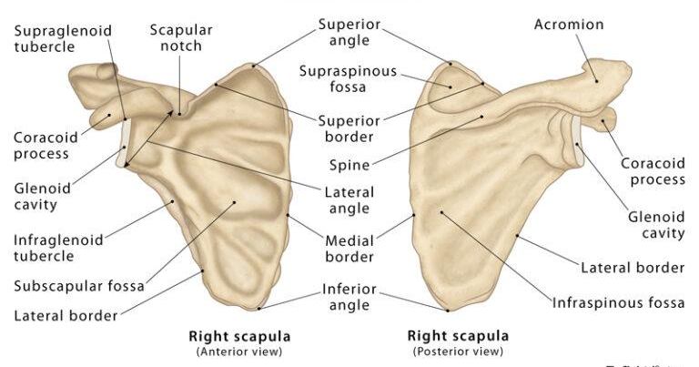
Acromion
(Clavicle)
Key bony landmarks
Scapula:
Coracoid process
Spine of scapula
Acromion

Slide 6
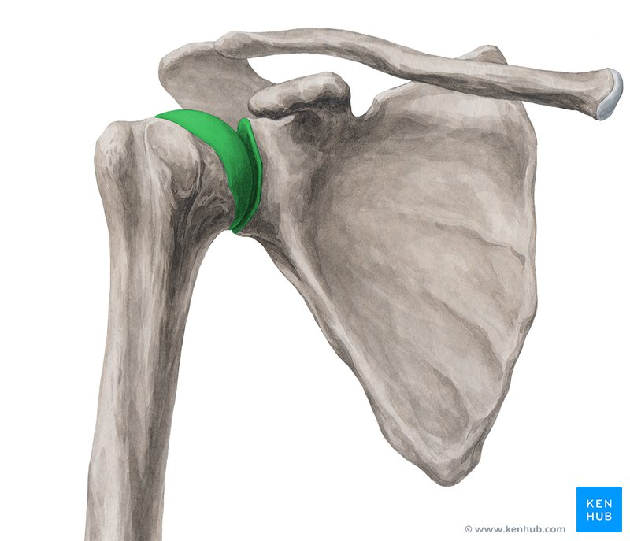
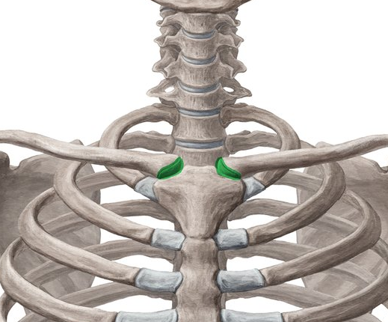
Acromioclavicular joint
Sternoclavicular joint
Joints
Glenohumeral joint
The bones (humerus, scapula, clavicle) form the three joints of the shoulder:-
1. Glenohumeral joint (GH)
- true shoulder joint - where the
main movement comes from
2. Acromioclavicular (AC)
- where the acromion meets the
clavicle
3. Sternoclavicular (SC)
- where sternum (chest bone)
meets the clavicle
Also - Scapulothoracic!

Slide 7
1. Glenohumeral joint
Head of the humerus
Classification = A synovial ball and socket joint formed by the head of the humerus and the shallow
glenoid cavity (fossa) of the scapula
Multi-axial
Movements available =
Planes of movement =
Axes of movement =
Ligaments limit movement at this joint, and are critical to stability and function
Stability is also provided by muscles - mainly the rotator cuff muscles
flexion, extension, adduction, abduction, medial rotation, lateral rotation, horizontal adduction, horizontal abduction
sagittal, frontal and transverse
Glenoid cavity
medial-lateral, anterior-posterior and
superior-inferior

Slide 8
Special features of the glenohumeral joint
The humeral head is a lot larger in relation to the depth of the glenoid cavity + glenoid labrum
What is the benefit of this?
What is the disadvantage of this?
allows greater range of movement (ROM)
- most mobile joint in the body
stability is compromised
- most often dislocated joint in the body

Slide 9
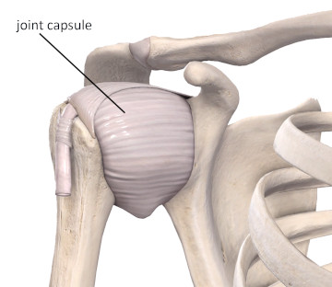
Special features cont…
also, the laxity of the joint capsule allows extensive ROM
and further ROM is aided by movement at acromioclavicular and sternoclavicular joints

Slide 10
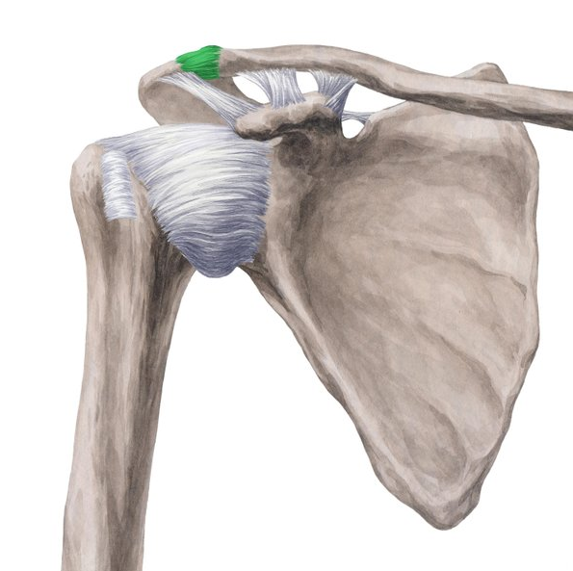
2. Acromioclavicular joint
Acromioclavicular joint
Classification = A synovial gliding joint
Movements available = protraction/retraction, elevation/depression
Planes of movement =
Axes of movement =
transverse, and frontal
superior-inferior, anterior-posterior

Slide 11
3. Sternoclavicular joint
Sternoclavicular joint
Classification = A synovial saddle joint
Movements available = protraction/retraction, elevation/depression
Planes of movement =
Axes of movement =
transverse, and frontal
superior-inferior, anterior-posterior

Slide 12
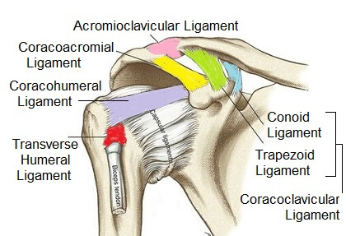
Stabilisers
Glenohumeral ligaments (x3 bands)
Coracohumeral ligament
Transverse humeral ligament
Acromioclavicular ligament
Coracoclavicular ligament
Articular capsule
Glenoid labrum
Glenohumeral Ligaments

Slide 13
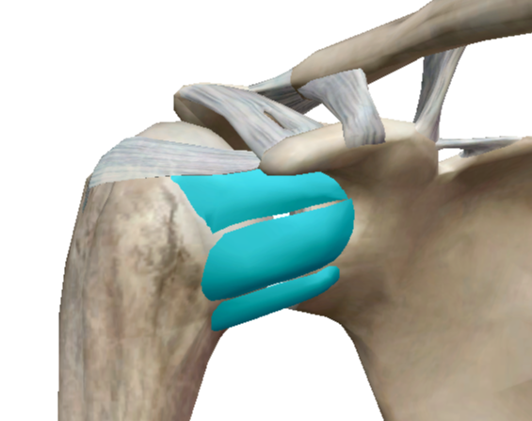
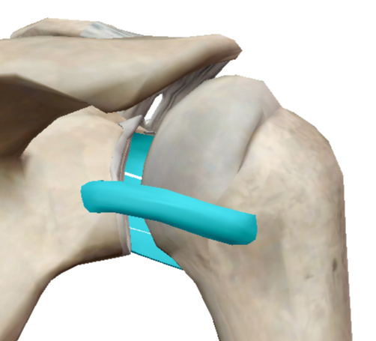
Glenohumeral ligaments
Superior
Mid
Role - to prevent external rotation and inferior/anterior translation of humeral head
Superior glenohumeral ligament
Mid glenohumeral ligament
Inferior glenohumeral ligament - 2 bands
Inferior
(anterior band)
(posterior band)

Slide 14
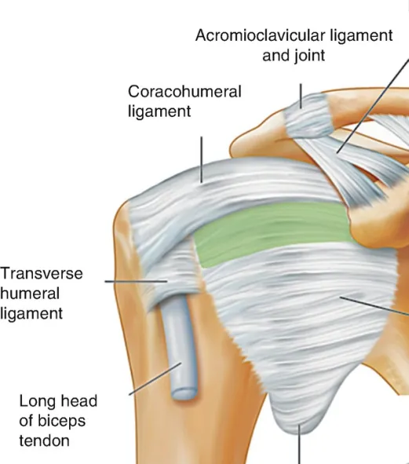
Ligaments
Coracohumeral ligament
- strengthens superior part of joint capsule
- restricts post-inf shift of humeral head
Transverse humeral ligament
- holds long head of biceps brachii tendon
Acromioclavicular ligament
- horizontal stability
- prevents superior dislocation of AC joint

Slide 15
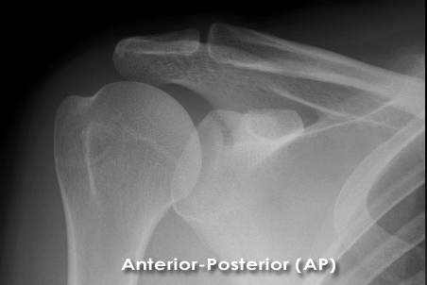
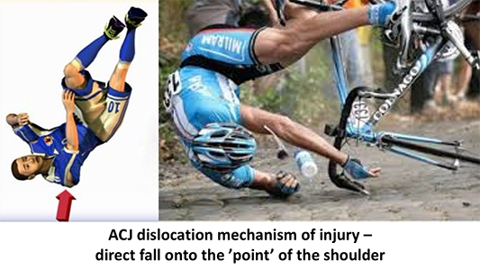
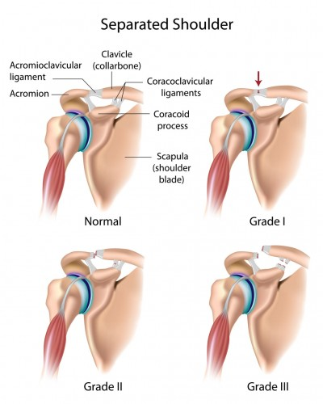
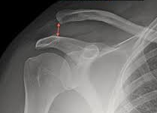
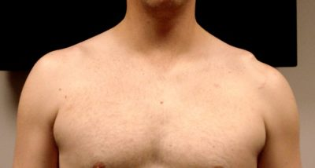
ACJ injury
MOI - falling directly onto top (‘point’) of shoulder
Aetiology - rupture of AC and CC ligaments

Slide 16
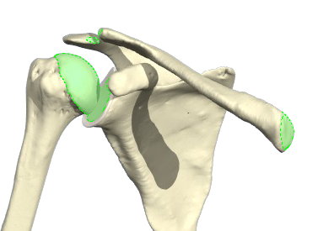
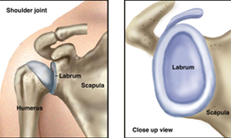
Other structures
Joint capsule
- surrounds the GHJ
- dense fibro-cartilage
- very lax - allows ROM, no role in support
Articular cartilage
- hyaline cartilage that lines the humeral head
and glenoid cavity, also the AC and SC joints
Glenoid labrum
- fibrocartilage ring that attaches to the
articular cartilage of glenoid fossa
- deepens the socket

Slide 17
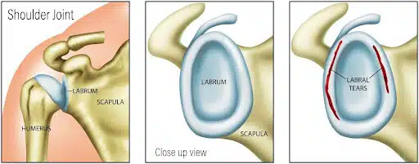
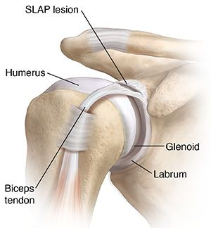
Glenoid Labrum
fibrocartilage ring that attaches to the articular cartilage of glenoid fossa
deepens the socket and increases the surface area (acting as a static stabiliser of the GHJ)
resists anterior and posterior movement, and assists with blocking shoulder dislocation and subluxation at the maximal ROM
can be easily damaged acutely (e.g. dislocation) or by repetitive microtrauma (e.g. overhead athletes) - most common SLAP lesion (superior labral anterior posterior, at insertion of biceps tendon)

Slide 18
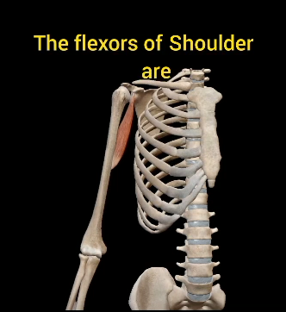
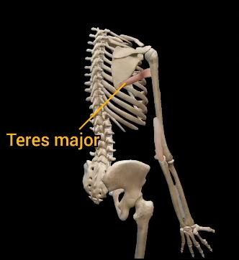
GH Joint movements
Flexion of the humerus
muscles involved:-
Pectoralis major
Anterior deltoid
Coracobrachialis
Biceps brachii (when the forearm is flexed)
Extension of the humerus
muscles involved:-
Latissimus dorsi
Teres major
Posterior Deltoid
Triceps brachii (when the forearm is extended)

Slide 19
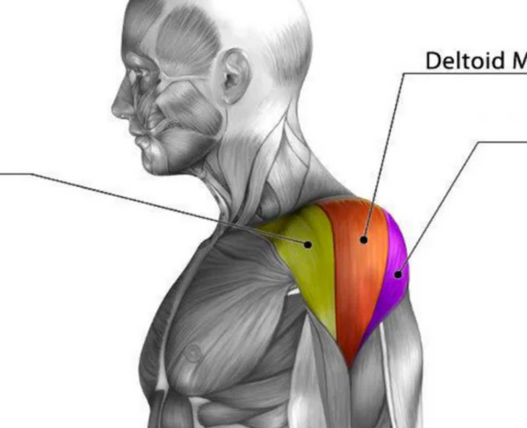
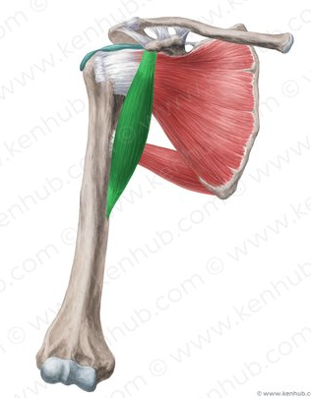
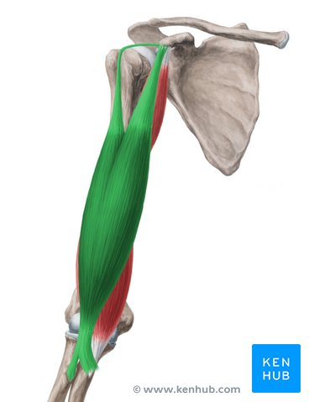
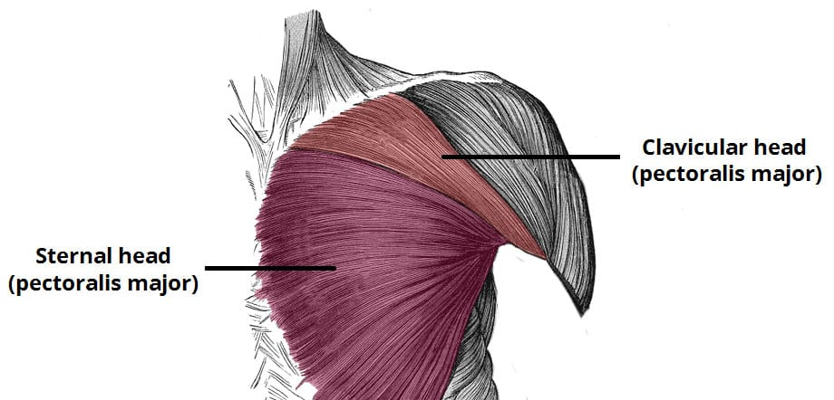
Visible Body
Flexors
Mid
Posterior
Coracobrachialis
Anterior deltoid
Biceps brachii
- long and short head
Anterior deltoid
Long head
Pectoralis major
- sternal and clavicular fibres
Short head

Slide 20
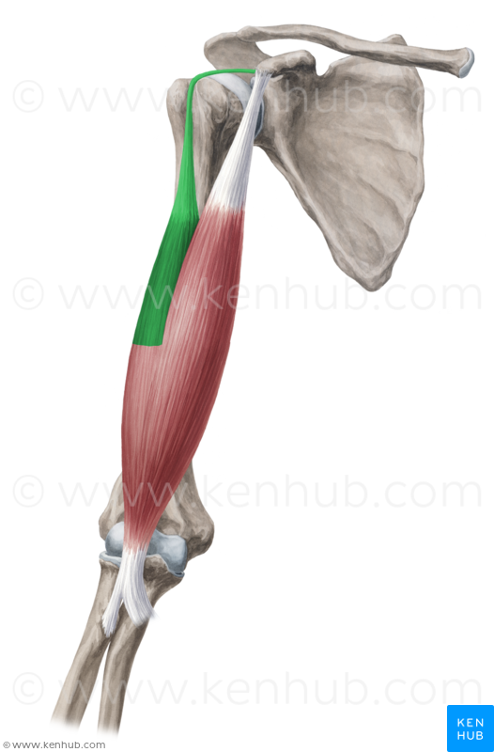
Biceps Brachii
The tendon of long head of the biceps brachii also acts as an elastic ligament
It strengthens the upper part of the articular cavity
During contraction of the deltoid, it prevents the head of humerus from pushing superiorly against the acromion
Holds head of the humerus in contact with the glenoid cavity i.e. preventing displacement

Slide 21
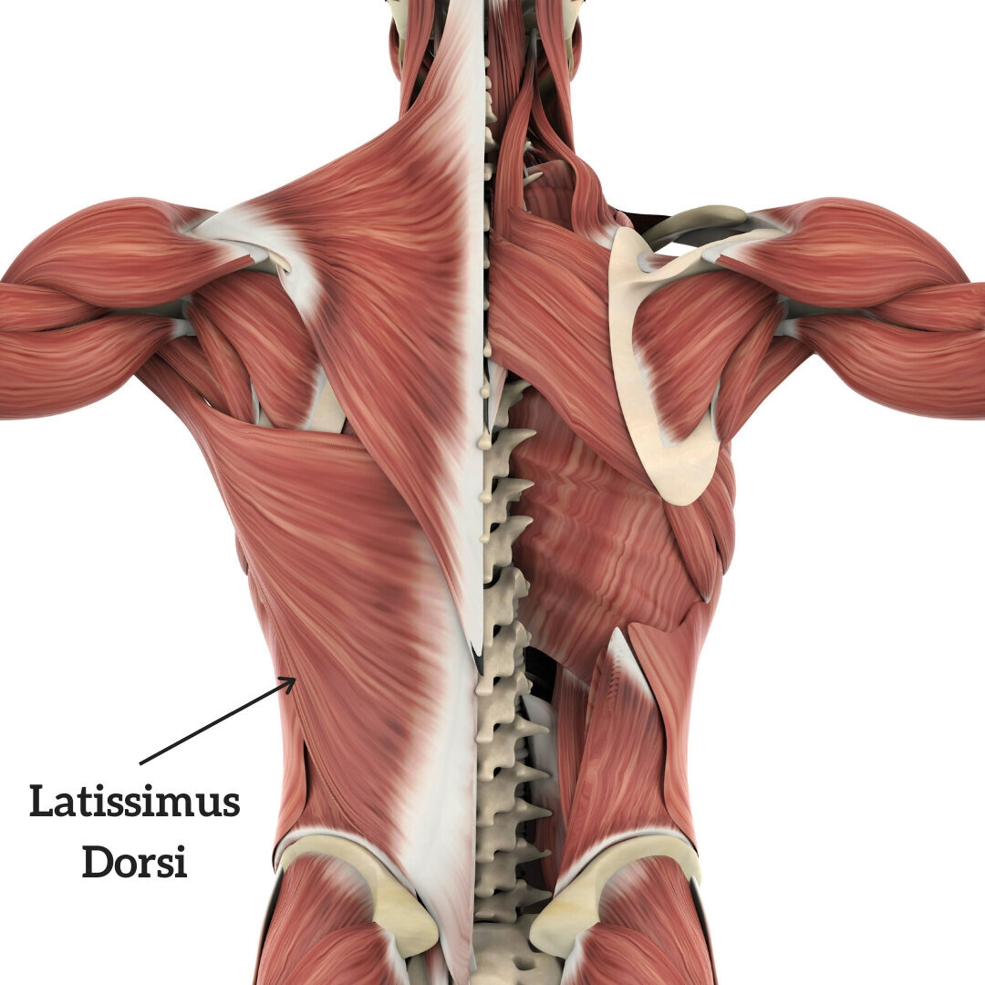
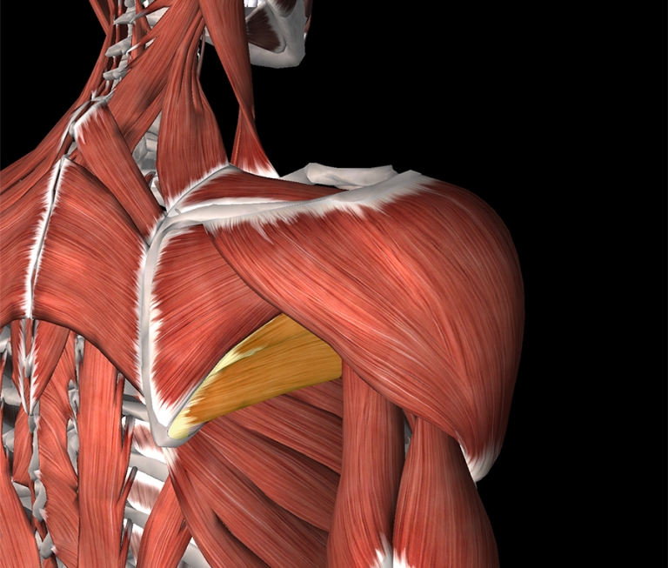
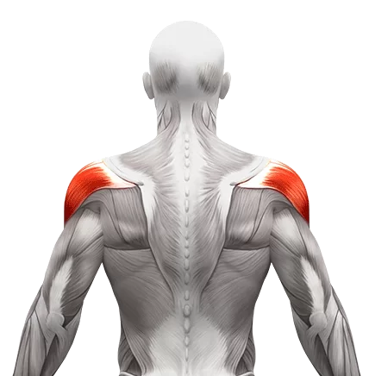
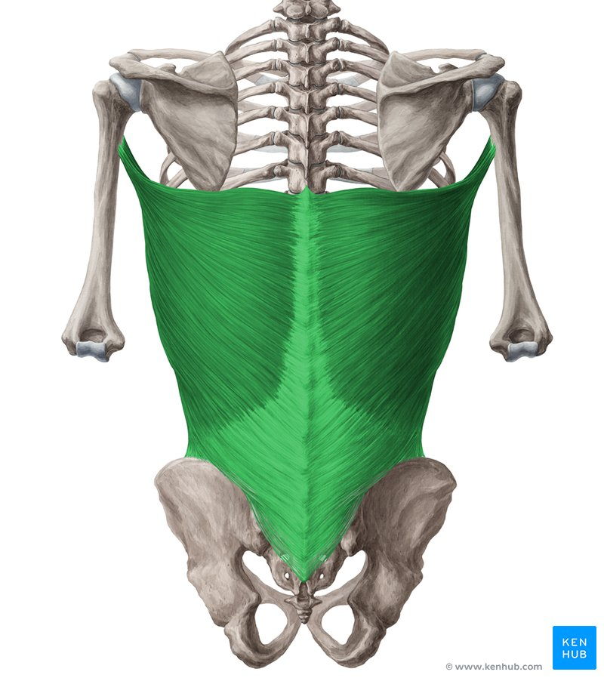
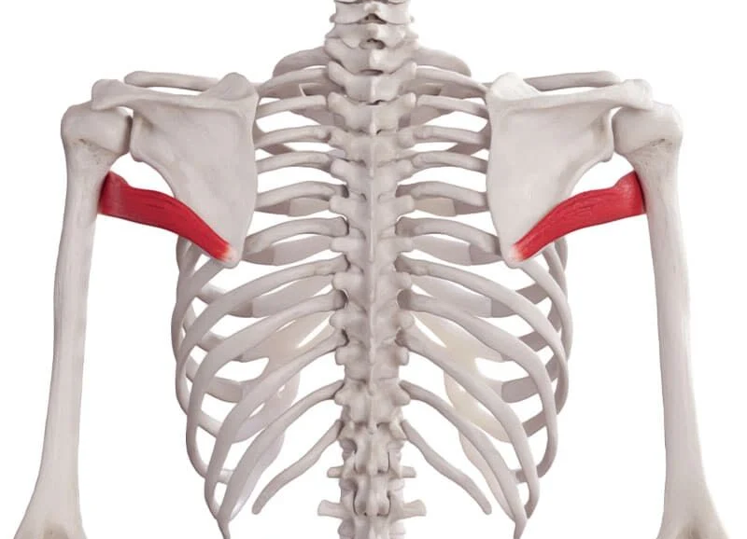
Extensors 1
Posterior fibres of deltoid
Latissimus dorsi
Teres major

Slide 22
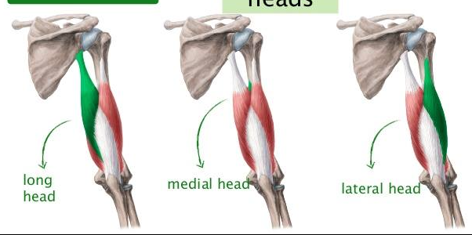
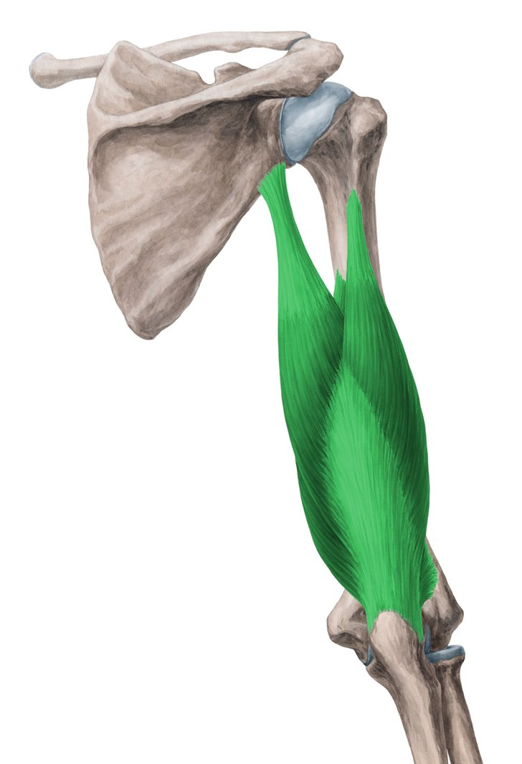
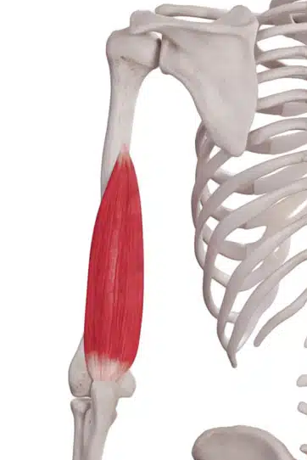
Extensors 2 - Triceps brachii long head
Medial head

Slide 23
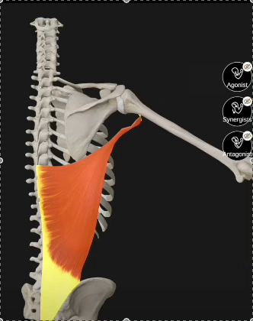
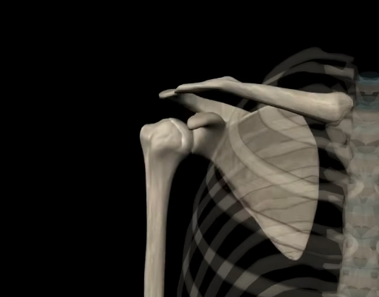
Abduction and Adduction
Adduction
muscles involved:-
Latissimus dorsi
Teres major
Subscapularis
Pectoralis major
Abduction
muscles involved:-
Deltoid
Supraspinatus

Slide 24
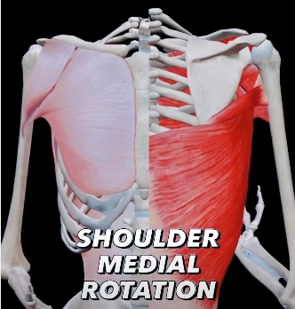
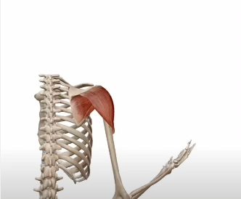
Medial and Lateral Rotation
Anterior
Posterior
Medial rotation
muscles involved:-
Latissimus dorsi
Teres major
Subscapularis
Pectoralis major
Anterior Deltoid
Lateral rotation
muscles involved:-
Infraspinatus
Teres minor
Deltoid (weak)

Slide 25
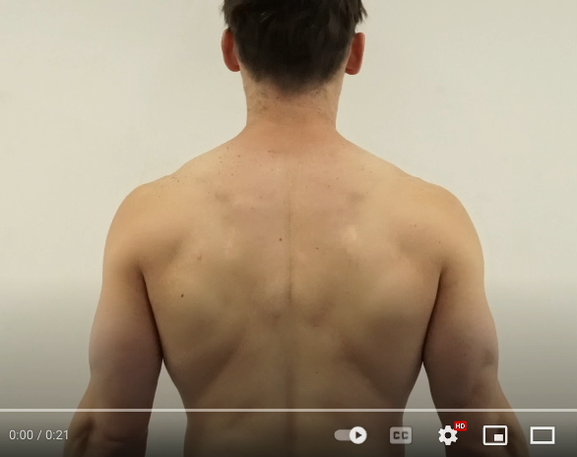
Scapula Movements
Elevation (raise)
muscles involved:-
Trapezius (upper portion)
Levator scapulae
Protraction (forward)
muscles involved:-
Serratus anterior
Pectoralis minor
Pectoralis major assists when the arm is fixed
Depression (lower)
muscles involved:-
Trapezius (lower portion)
Pectoralis minor
Subclavius (through clavicle)
Retraction (backward)
muscles involved:-
Rhomboids
Trapezius (middle and lower portions)

Slide 26
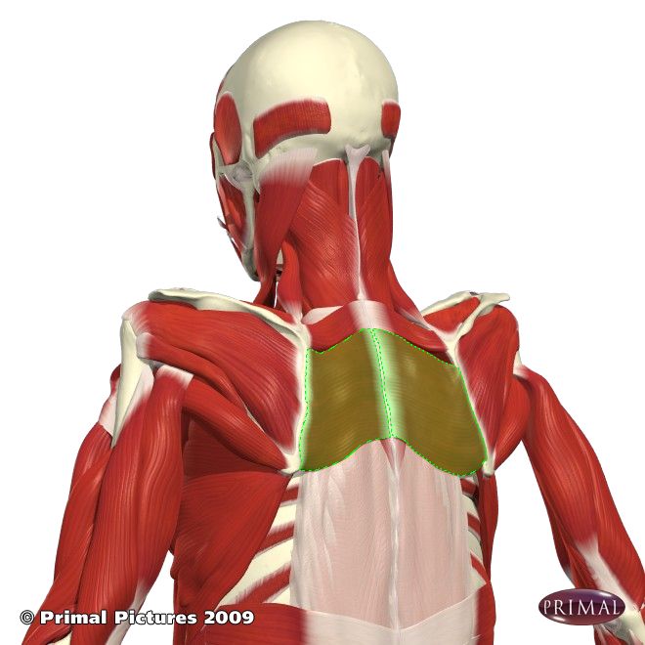
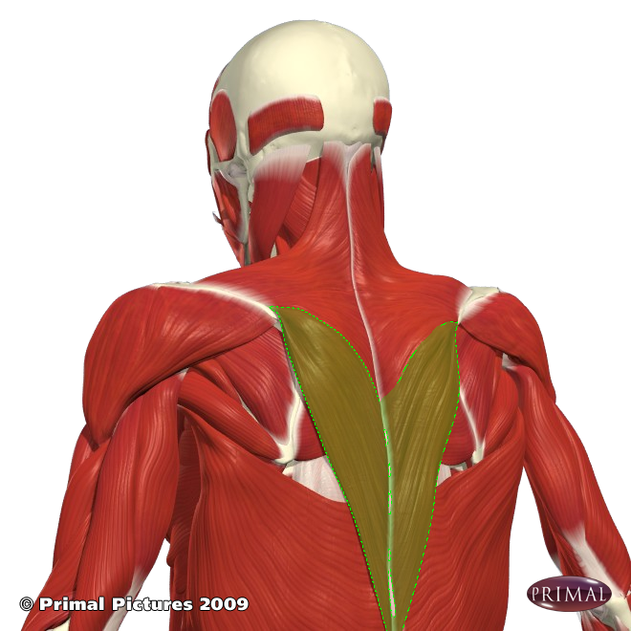
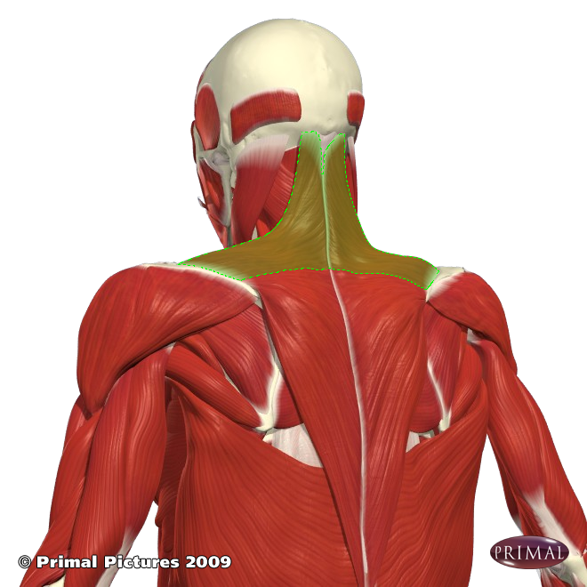
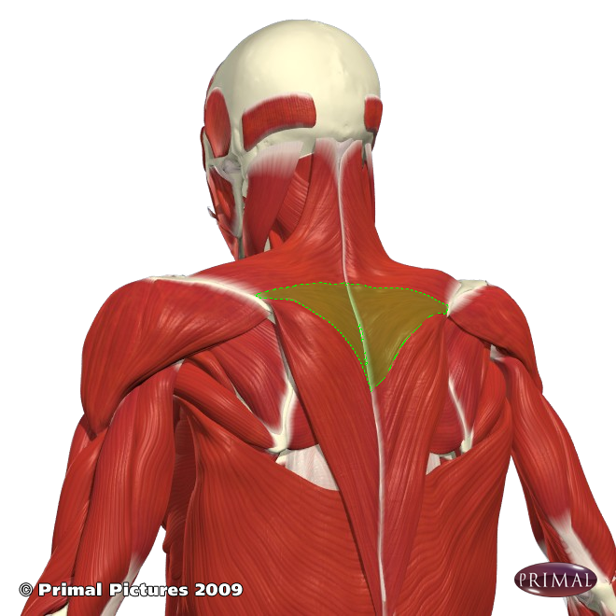
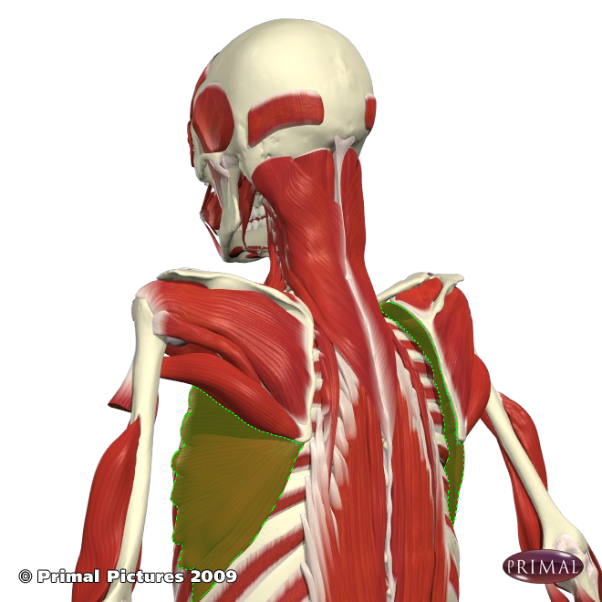
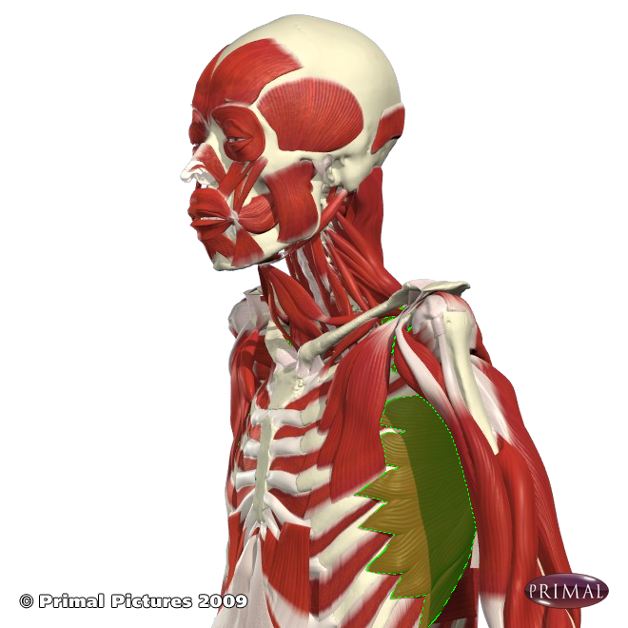
Important scapula stabilisers/movers
Rhomboids
Trapezius lower fibres
Trapezius upper fibres
Serratus anterior
Trapezius mid fibres

Slide 27
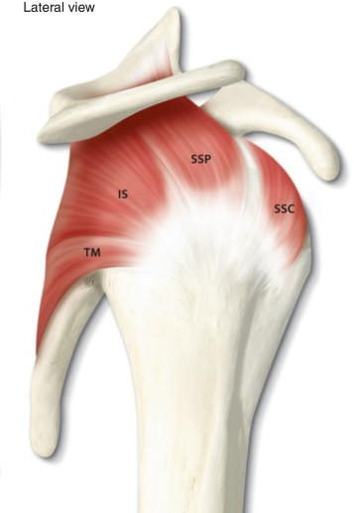
Rotator Cuff
Lateral view of right shoulder
A group of 4 muscles
Supraspinatus
Infraspinatus
Teres minor
Subscapularis
SSp
SITS
I
superior
to inferior
SSc
T
They are stabilisers for the GHJ, keeping the humeral head firmly in place
They also provide movement
You must have an excellent understanding of the movements and attachment sites for these muscles
posterior
anterior

Slide 28
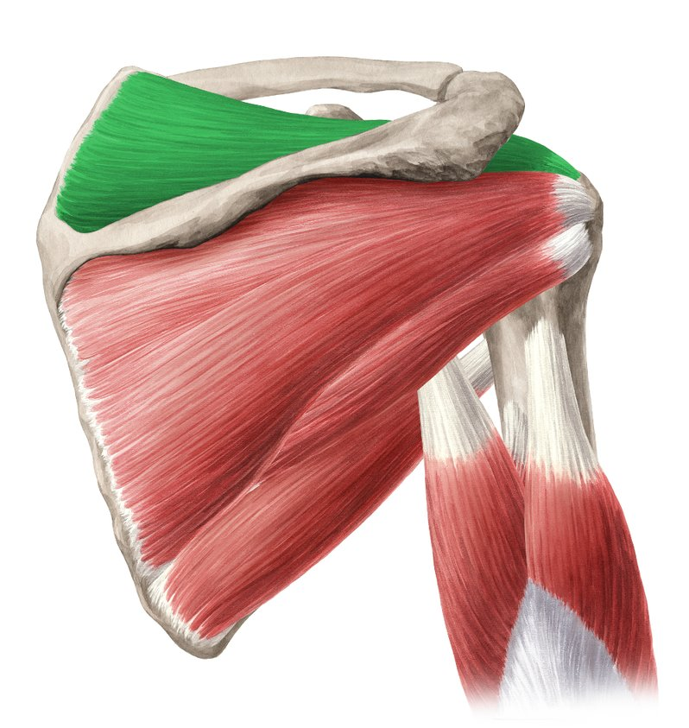
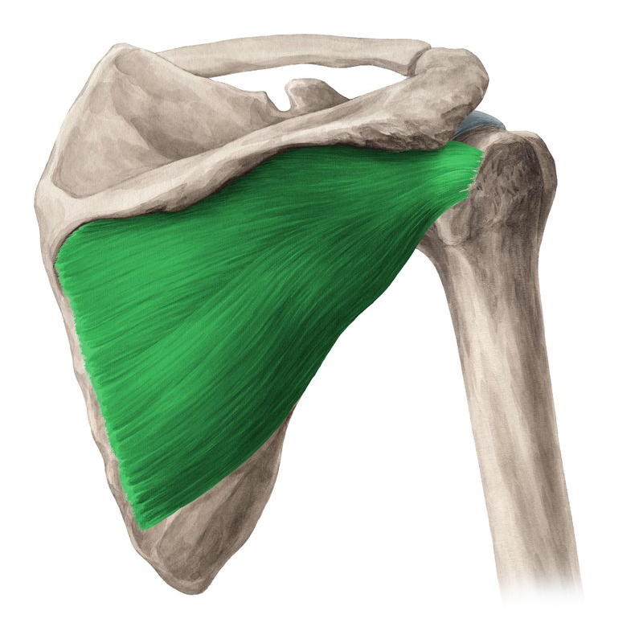
Rotator Cuff muscles
Supraspinatus
Supraspinatus
Action: first 20° of abduction
O: supraspinous fossa
I: greater tubercle of humerus
Infraspinatus
Action: external rotation
O: infraspinous fossa
I: lateral, superior humerus
posterior
Infraspinatus
posterior

Slide 29



Subscapularis
Rotator Cuff muscles
Subscapularis
Action: internal rotation
O: subscapular fossa
I: lesser tubercle of humerus
Teres minor
Action: external rotation and adduction
O: infraspinous fossa (below infraspinatus)
I: lateral, superior humerus (blow infraspinatus)
anterior
Teres minor
posterior

Slide 30


Rotator Cuff
Supraspinatus
Acromion
Biceps tendon (long head)
Coracoid
Infraspinatus
Subscapularis
Teres minor

Slide 31
Task
The following slides list muscle origins, attachments, and innervation.
Go back to the muscle slides and relate these to each to each of the muscles.
If there are any missing, do some research and fill in the gaps.
Do the self-assessment questions at the end.
Thank you for listening!

Slide 32

Muscle origins, insertions and innervation

Slide 33



Slide 34


Slide 35


Slide 36


Slide 37



Slide 38



Slide 39



Slide 40


Slide 41
Self Assessment Questions
What are the attachments of the pectoralis minor muscle?
What is the nerve supply of the deltoid muscle?
Which is the main muscle involved in shrugging the shoulder?
What is the nerve supply to the rhomboid muscles?
Which muscle of the scapula attaches to the lesser tubercle of the humerus?
Which muscles are innervated by the axillary nerve?
Name the rotator cuff muscles.
Which muscle is the most powerful internal rotator of the humerus?
Which muscle initiates abduction of the humerus?

